Slide 1
Chapter 11
What Works and What Doesn’t (Part 3, Identification)

Slide 2
The Reflection Problem
The treatment and the outcome you want to measure move together
  E.g., the people who get the treatment are more likely to have a better outcome even without the treatment
  No problem if treatment is random, but usually true randomization is not possible
Like a Hall of Mirrors: How can you separate the bad guy (the treatment) from his reflections (the outcome?
Some pistachio nuts could help…
They are an “instrument”

Slide 3
A Nation of Immigrants
When There Is No Experiment
Source: World Bank
Notes:
Put all in one country, would create a “nation of immigrants” which would be the world’s 6th largest country, with population greater than the size of Japan.
Seems like a lot
Lead in to next slide:
Look at it another way. Next Slide: World Migration Propensities

Slide 4
Do Migration and Remittances Promote Development?
Big selection problem here
  The less control people have over whether get the treatment, the better, but…
  People choose whether or not to migrate
Dean Yang came up with what might be the next best thing…
  Studied impacts of migration in the Philippines
His instrument came from the Asian financial crisis

Slide 5
How to Get an Instrument for Remittances from an Economic Crisis
When the crisis hit in 1997, Philippine households had migrants in many different Asian countries
  Many households had migrants in more than one country
The Philippine peso devaluated more against some Asian countries than others
  When the peso devalues, the value of remittances in pesos increases
  For example, each Hong Kong dollar a migrant sent home turned into more Philippine pesos than before the crisis.

Slide 6
Almost As Good As Random
The impact on each household’s remittances depended on where its migrants happened to be when the crisis hit
  The more the peso devalued against the country where your migrants were, the bigger the increase in remittances
Nobody expected the crisis to happen
That, Dean argued, makes the changes in remittances almost as good as random

Slide 7
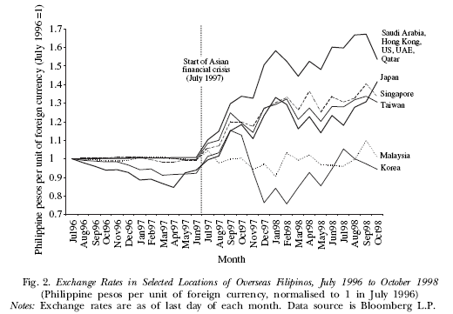
Dean Yang: Asian Financial Crisis as “Natural Experiment”

Slide 8
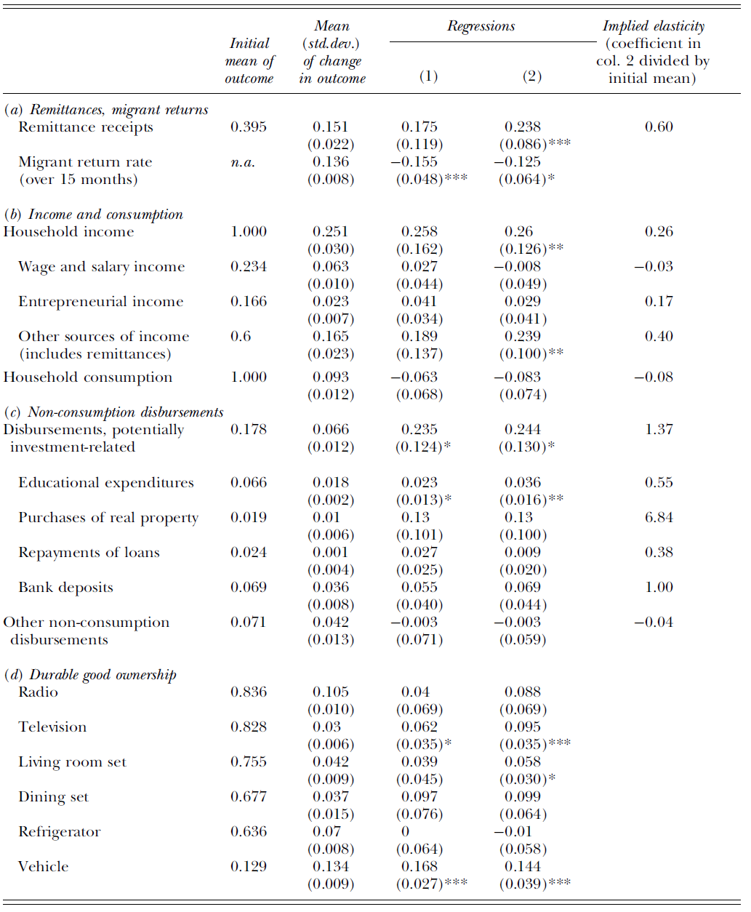
How Exchange Rate Shocks Affected Philippine Households
Asterisks mean impact is statistically significant
Model (2) Includes Controls for rural/urban and household characteristics before the crisis

Slide 9
When There Is No Experiment
Witch Killing in Tanzania

Slide 10
Witch Killing in Rural Tanzania
Witchcraft is a tangible reality for many Tanzanians and witches are considered criminals just as dangerous as ordinary thieves and murderers
Edward Miguel
  "In the Sukuma community, if you kill a witch it is not really considered a crime. It's like you are doing something for the community“
  BBC News

Slide 11
Average of 0.2 Witch Killings/village/year in the W. Tanzanian Region Ted Studied
Mostly older women
Mostly by relatives
Almost never prosecuted
Mostly in pre-harvest period
  Food stores lowest
  Next harvest known
  Harvesting takes a lot of energy => food

Slide 12
Economic Hypotheses
Income Shock Theory (IST)
  Big negative income shocks associated with extreme weather are the driving force behind witch killings
  Extreme rainfall and disease epidemics are both shocks that "witches" can control according to the ethnographic literature on Tanzania
Extreme scarcity theory (a variant of IST)
  Households near subsistence consumption levels kill, expel, or starve relatively unproductive elderly household members to safeguard the nutritional status of other members
Only shocks affecting income explain witch-killing

Slide 13
Other Explanations
Cultural Norms
  Elderly women witches must be killed following extreme rainfall, but not after other calamities or events (no evidence for this)
Scapegoat theory
  Both extreme weather and disease shocks should lead to more witch murders, as households eliminate the "cause" of their suffering

Slide 14
Poverty and Violence
(Ted Miguel is the big name here*)
Nasty identification problems
  Crime impedes development
  …but poverty and weak institutions are associated with crime, too
  How sort it out? How figure out whether poverty affects crime?
  Ted Miguel used the weather
Check out: Fisman and Miguel, Economic Gangsters: Corruption, Violence, and the Poverty of Nations (Princeton, 2010)

Slide 15
Identification Strategy
Use local rainfall variation to identify the impact of income shocks on murders in a rural Tanzanian district
"Has this village faced any natural disasters or calamities in the past ten years? (Prompt: For example, drought, famine, floods, locusts.)"
Murders in the village during the previous 10 years, and if so, the number and years of the murder
  There was a remarkable openness in discussing witch killings
Weather shocks: exogenous and associated with poor harvests and near-famine conditions in the region
…and a large increase in the murder of "witches"

Slide 16
Identification
Income=f(extreme rainfall shock, disease shock, other variables)
Witch Killings=g(extreme rainfall shock, disease shock, other variables
If scapegoat theory is right, both shocks should explain witch killings
If economic theory is right, only the shock(s) that affect income should affect witch killings
Notice how Ted avoids having to directly test relationship between income/poverty and crime
Weather is random; it’s his instrument

Slide 17
b
a
Weather Shock
Income
Witch Killings

Slide 18
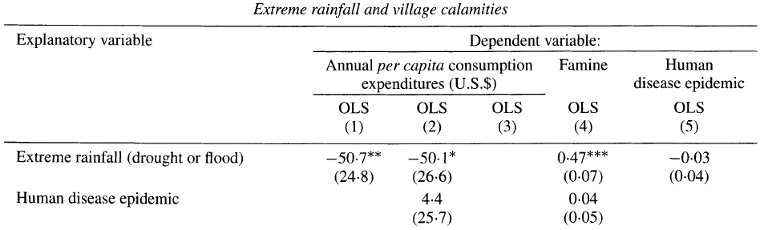
Results: (a) Income
Significant!
Not Significant!

Slide 19
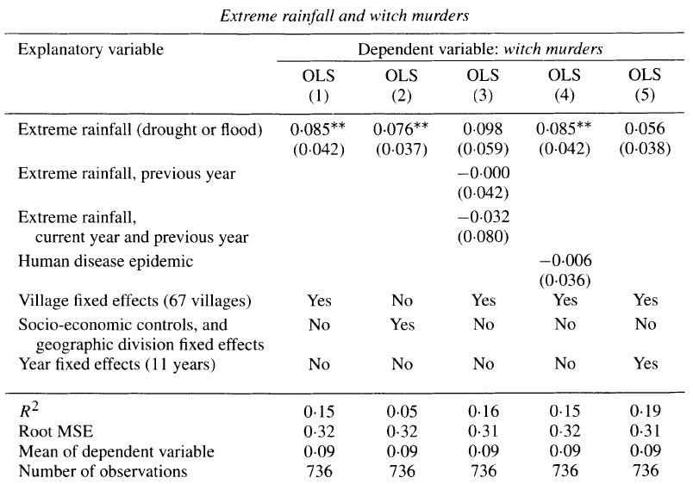
Results: (b) Witch Killings
Significant!
Not Significant!

Slide 20
“Only the shock that leads to lower income (extreme rainfall) results in more witch murders, while disease epidemics lead neither to lower income nor to witch murders empirically.”

